Slide 1
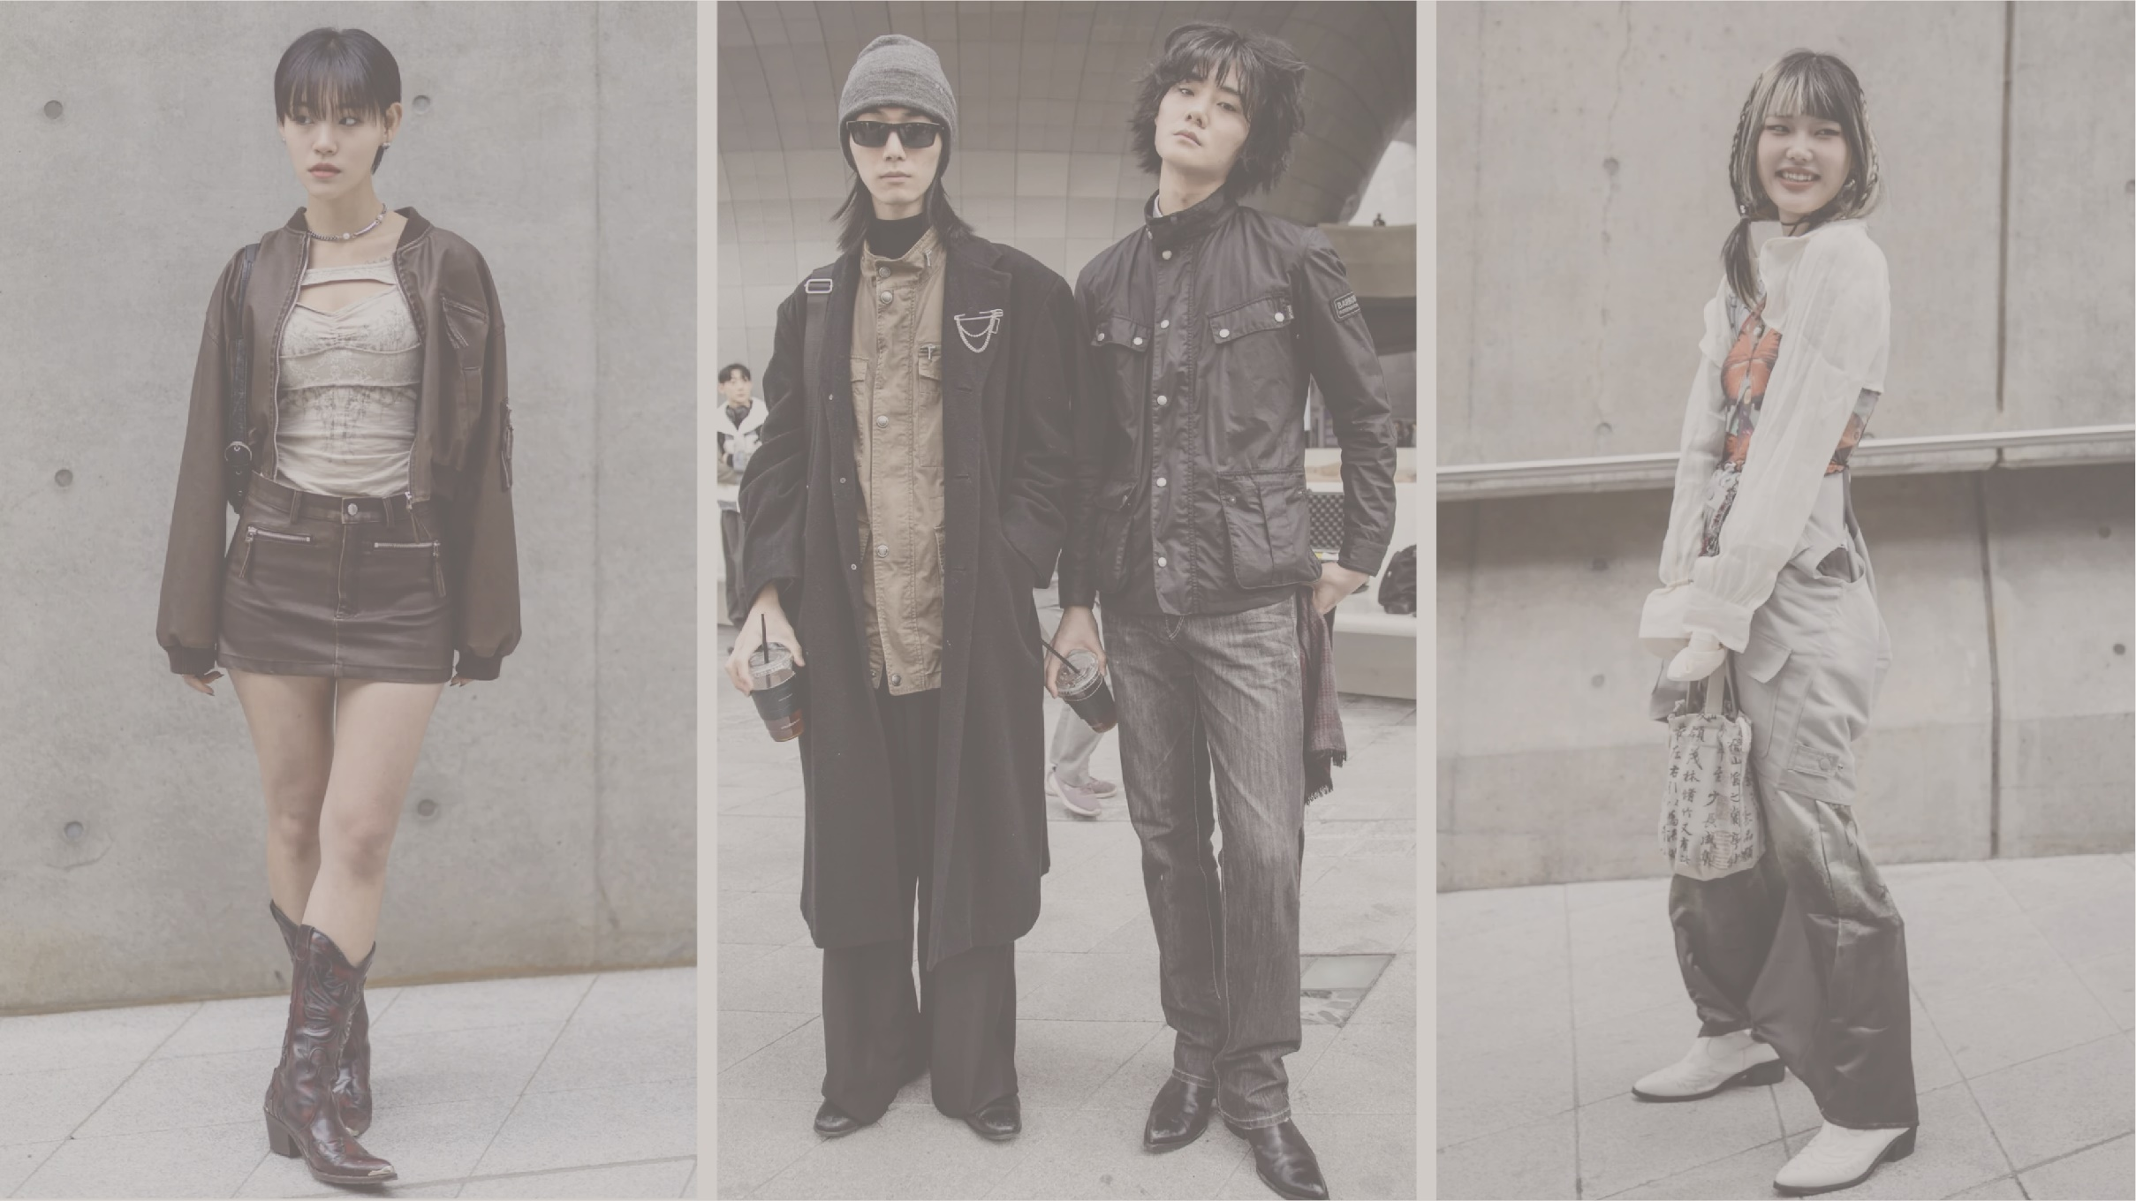
2024 Brand Concept
FASHION FORWARD
Chan Hyun Yoo
05.08.2024
https://github.com/chhhhhyoo/FashionRecommendation
Page 01

Slide 2
G마켓 산스 medium
Report Index
Montserrat semibold
나눔고딕
01. Motivation
Page 2
Project Overview
02. Executive Summary
Page 3
03. Method & Approach
Page 4
04. Implementation & Experimentation
Page 5
Project Walkthrough
05. Demo
Page 6
06. Results & Experimental Evaluation
Page 7

Slide 3
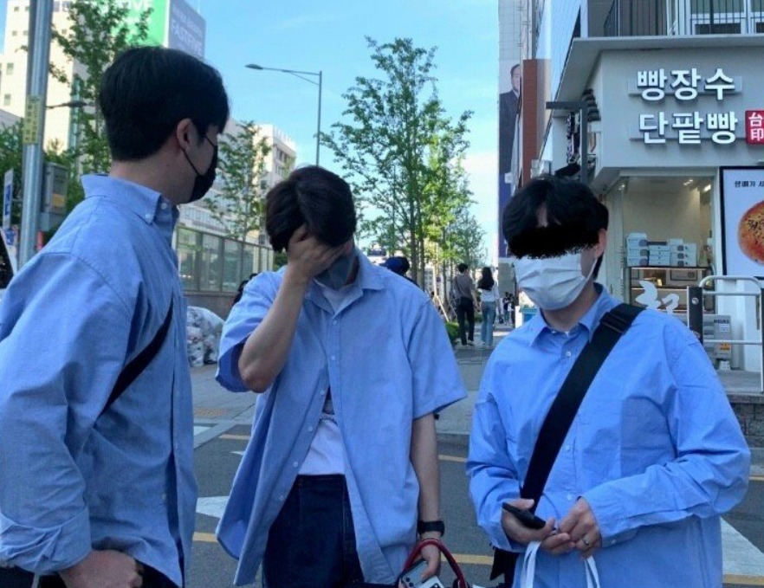
G마켓 산스 medium
01. Motivation
Montserrat semibold
나눔스퀘어
https://wenxinxublog.wordpress.com/2017/01/06/deep-shopping/
Page 2

Slide 4

02. Executive Summary
PROBLEM
MODEL ARCHITECTURE DESIGN
BASE CODE SETUP
HYPERPARAMETER TUNING
TEST RUN
TEST RUN
FINAL RUN
GOAL
Page 3

Slide 5
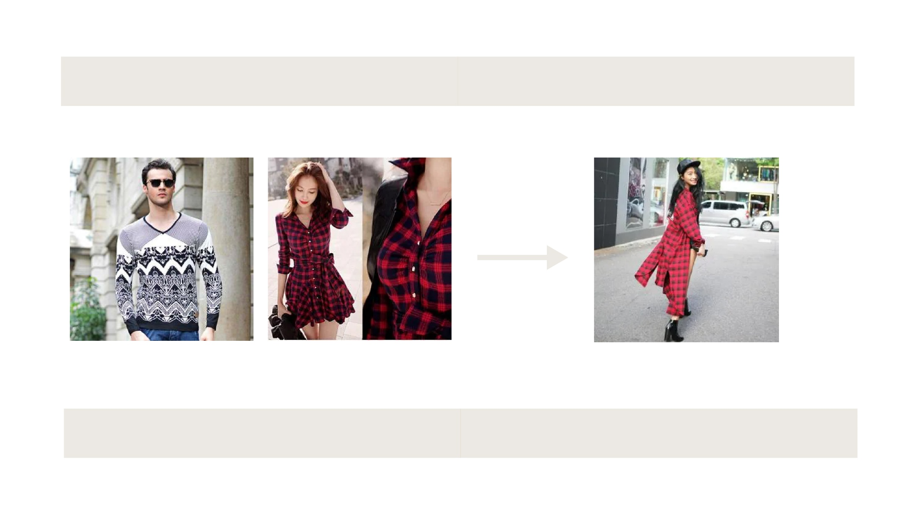
03. Method & Approach
ResNet
Output
ResNetV2
Ensemble & Transfer
Page 4

Slide 6
04. Implementation & Experimentation
HYPERPARAMETERS
EARLY STOPPING
LEARNING RATE
MODEL CHECKPOINT
Page 5

Slide 7
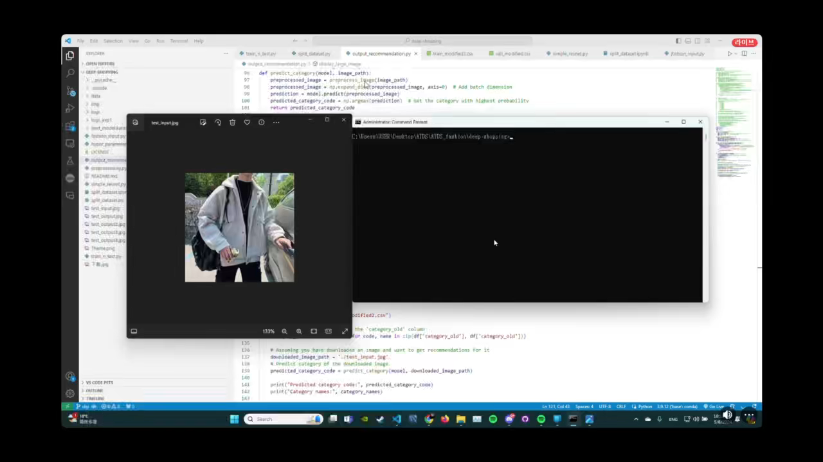
05. Demo
Page 6

Slide 8
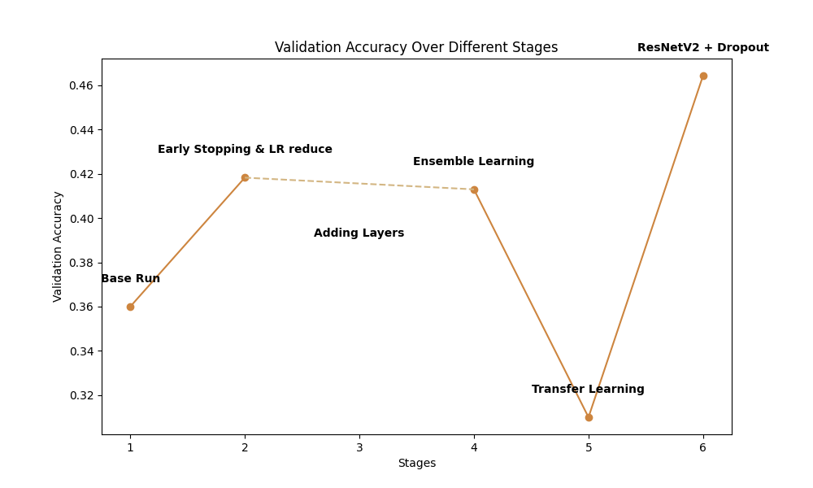
06. Results & Experimental Evaluation
Page 7

Slide 9
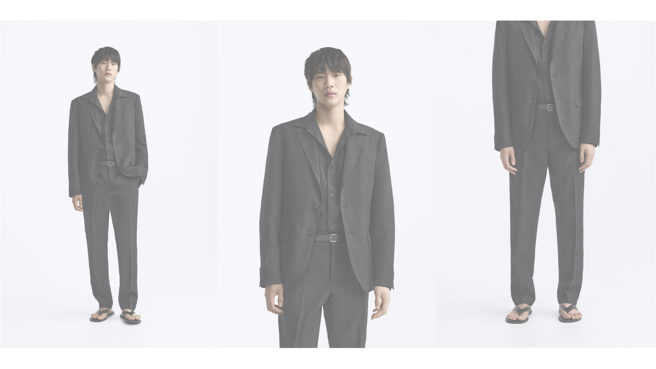
CONCLUSION
Page 8

